Slide 1
Applied A.I. Solutions Development Program
Deep Learning II
Waste Classification Service
Group 8
Bikash Giri (101575097)
Chia-Wei Chang (101570243)
Diparshan Bhattarai (1014947379)
Hsi-Teng Liu (101576074)
Gavriel Kirichenko (101119609)
Abdul-Rasaq Omisesan (101571156)
Callum Arul (101585383)
Friba Hussainyar (101591222)

Slide 2
Agenda
1. Introduction with Background and Problem Statement: (Bikash Giri)
2. The Dataset
Dataset introduction (Friba)
The Dataset Resplit Process: (Chia-wei Chang)
3. Model Description and Training & Evaluation & Hyperparameter Tuning
Vision Transformer Model with Transfer Learning: (Chia-wei Chang)
Origin model: (Hsi-Teng Liu)
Yolo with Transfer Learning: (Gabriel Kirichenko)
4. Benchmark datasets or methods, and compare the test results against those benchmarks: (Callum)
5. Discussion & Reflection (Abdul-rasaq)
6. Conclusion with Team Contributions Table (Diparshan)

Slide 3
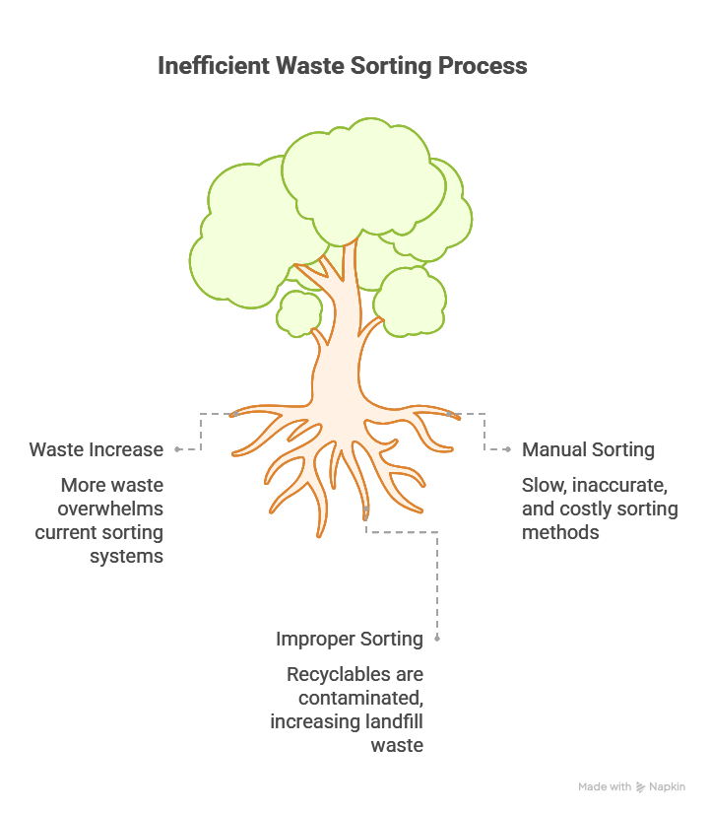
Introduction with Background
Global Waste Challenges
Increasing waste generation and poor sorting efficiency.
Manual sorting is time-consuming, labor-intensive, and error-prone.
Improper sorting leads to contamination of recyclables and increased landfill use.
Our Project
Build an AI-powered model to classify waste types.
Categories include: Cardboard, Glass, Metal, Paper, Plastic, Trash.
Designed for integration into a Smart BIN system for automatic sorting.

Slide 4
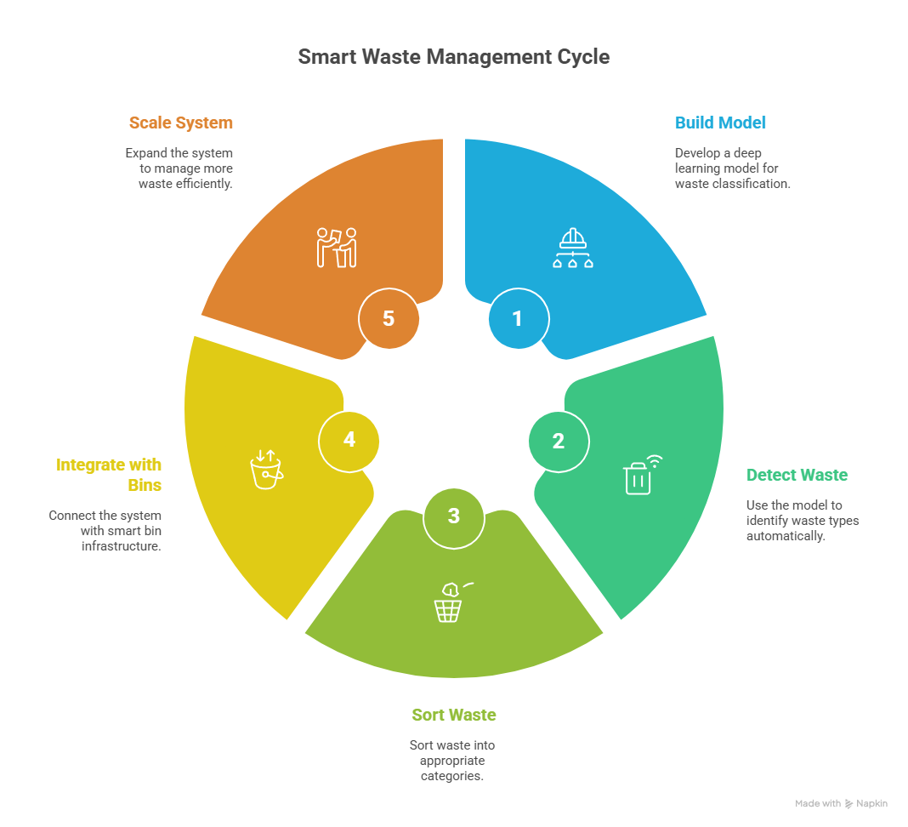
Problem Statement
The Problem
Improper waste disposal is a major global issue.
Manual Disposal is: Time-consuming, Prone to human error, Ineffective at scale.
Recyclables often end up as contaminated waste, leading to: Increased landfill overflow, Missed opportunities for recycling and Higher environmental impact.
What We Aim to Solve
Build a deep learning-based image classification model to: Automatically detect and sort waste types, Minimize human involvement in waste handling, Enable integration with Smart Bin systems and Support scalable, automated smart waste management.

Slide 5
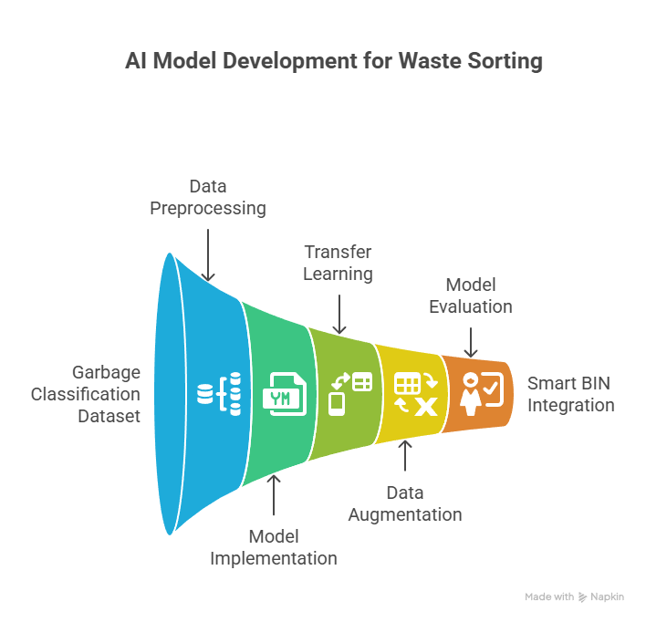
Plan of Attack
Strategy Overview
Dataset
Used Garbage
Classification with 10K+ images and 6 waste classes.
Preprocessing
Fixed class imbalance and Split into train/val/test (70/15/15).
Modeling
Trained YOLO and ViT with transfer learning and Applied strong augmentation.
Evaluation
Measured accuracy, misclassifications, and real-world readiness
Future Integration
Model will power an AI-driven Smart BIN for automated sorting

Slide 6
The Dataset
Dataset Name: Garbage Classification 3 Source: Roboflow Universe Link: https://universe.roboflow.com/material-identification/garbage-classification-3
This dataset is specifically designed for object detection in waste classification, making it a perfect match for our project's goals.
Total Images: 10,464
Classes (Object Types):
Cardboard
Glass
Metal
Paper
Plastic
Trash (general waste)
The dataset reflects real-world environments, helping to build models that can support AI-powered recycling and waste sorting systems, which are increasingly important in smart cities and environmental sustainability.
Annotations: Bounding boxes with labels
Use Case: Ideal for training object detection models like YOLO, VIT, and Faster R-CNN

Slide 7
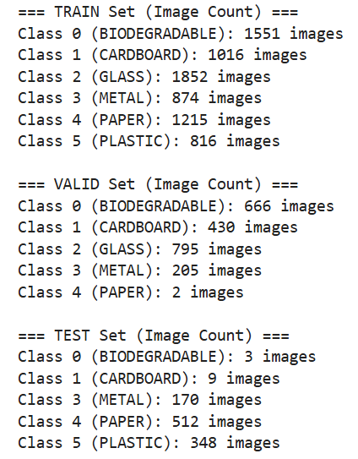
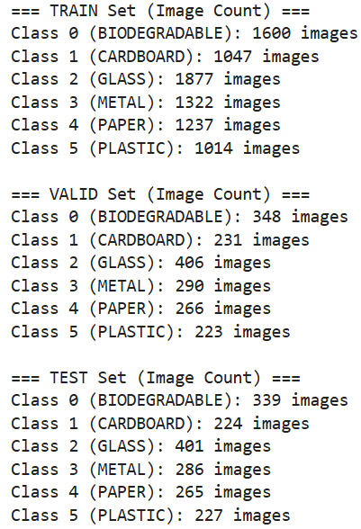
Original Dataset Imbalance
Resplit into 70/15/15
The Dataset Resplit Process
The original dataset had an uneven class distribution in the validation and test sets (e.g., only 2 PAPER images in valid, and only 3 BIODEGRADABLE images in test).
This could negatively affect model performance and evaluation accuracy.
class 5
To ensure balanced class distribution across all splits, we split the dataset using a 70% train, 15% validation, and 15% test ratio.

Slide 8
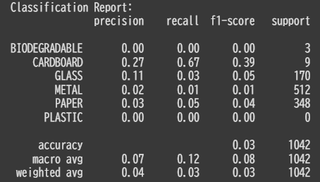
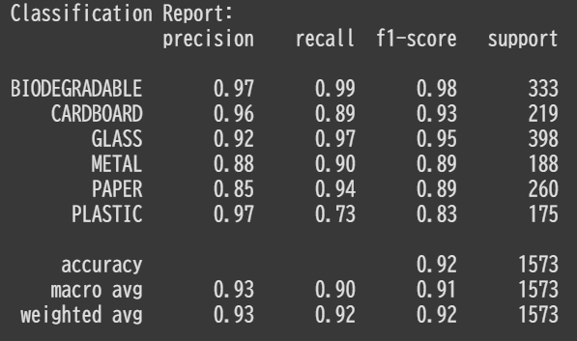
Training with ViT Tiny (vit_tiny_patch16_224)
Model: Vision Transformer (Full Fine-Tuning Model)
Google Colab Code Link
1. Original Dataset (Unbalanced)
Train Epochs: 10
Val Loss: 0.1214
Val Accuracy: 96.38%
BUT... Poor classification report: Accuracy Rate: 3%
2. Resplit Dataset (Balanced 70/15/15)
Train Epochs: 10
Val Loss: 0.3644
Val Accuracy: 91.9%
Classification improved significantly: Accuracy Rate: 93%

Slide 9
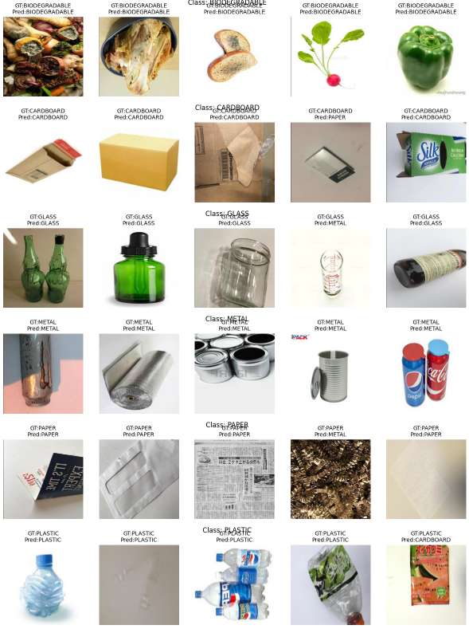
Prediction results of ViT-tiny Full Fine-Tuning Model
Each image shows the ground truth label (GT) and the model's prediction (Pred).
If the prediction is correct, GT and Pred are the same.
If it's wrong, GT and Pred are different.
We can observe:
Most predictions are correct, especially for BIODEGRADABLE, METAL, and PLASTIC.
There are still a few mistakes, like predicting GLASS as METAL, or PLASTIC as CARDBOARD.
These errors usually happen when the objects look similar, or the image is unclear.

Slide 10
Faster RCNN Resnet50 FPN
fasterrcnn_resnet50_fpn_v2 from pytorch
3 parts with 66 convolution layers
Backbone with FPN
Regional Proposal Network
ROI Heads

Slide 11
Faster RCNN Resnet50 FPN
Could not finish 1 Epoch in 24 hours
3 Trainable backbone layers
0 Trainable backbone layer
Total params: 43,281,778
Trainable params: 43,056,434
Non-trainable params: 225,344
Total params: 43,281,778
Trainable params: 19,773,746
Non-trainable params: 23,508,032

Slide 12
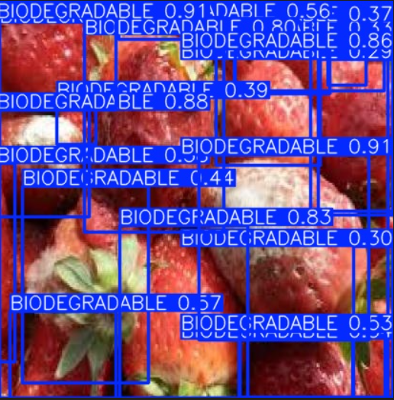
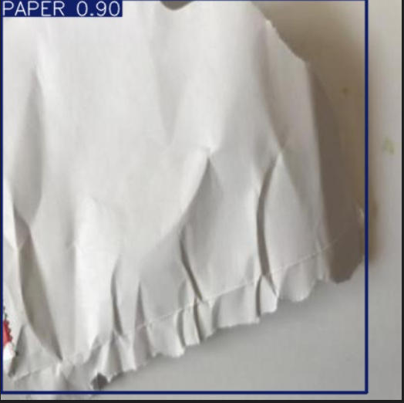
Yolo with Transfer Learning
Purpose: Automatically tune key hyperparameters of a YOLOv8 model for garbage classification using the Optuna optimization framework.
Key Components:
Objective Function:
Uses validation mAP@0.5 (mean Average Precision) as the optimization target.
Tuned Hyperparameters:
Learning Rate (lr0)
Momentum
Weight Decay
Augmentation Techniques: Mosaic, HSV (h, s, v), Flip, Erasing
Output:
Retrieves the best mAP@0.5 from results.csv for each trial to guide Optuna's search.

Slide 13
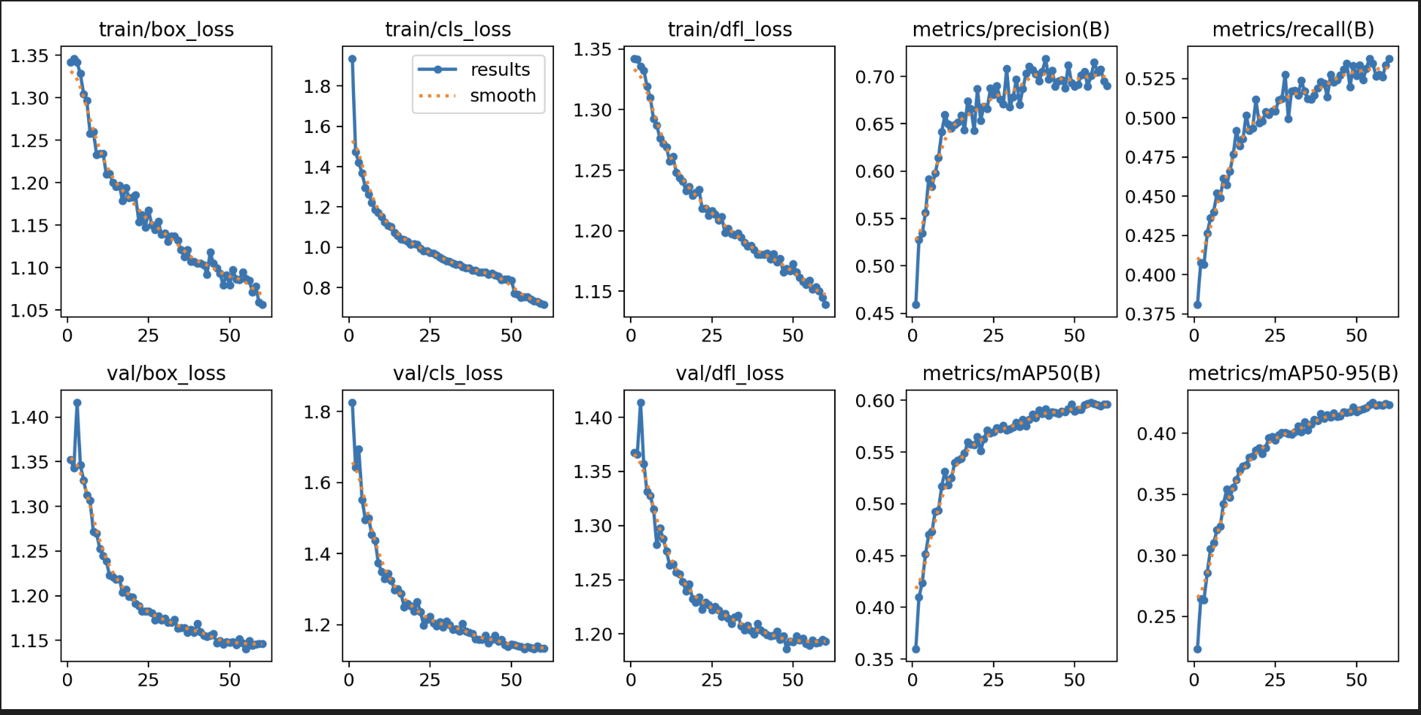
Training & Evaluation Metrics - YOLOv8 Performance Across 60 Epochs

Slide 14
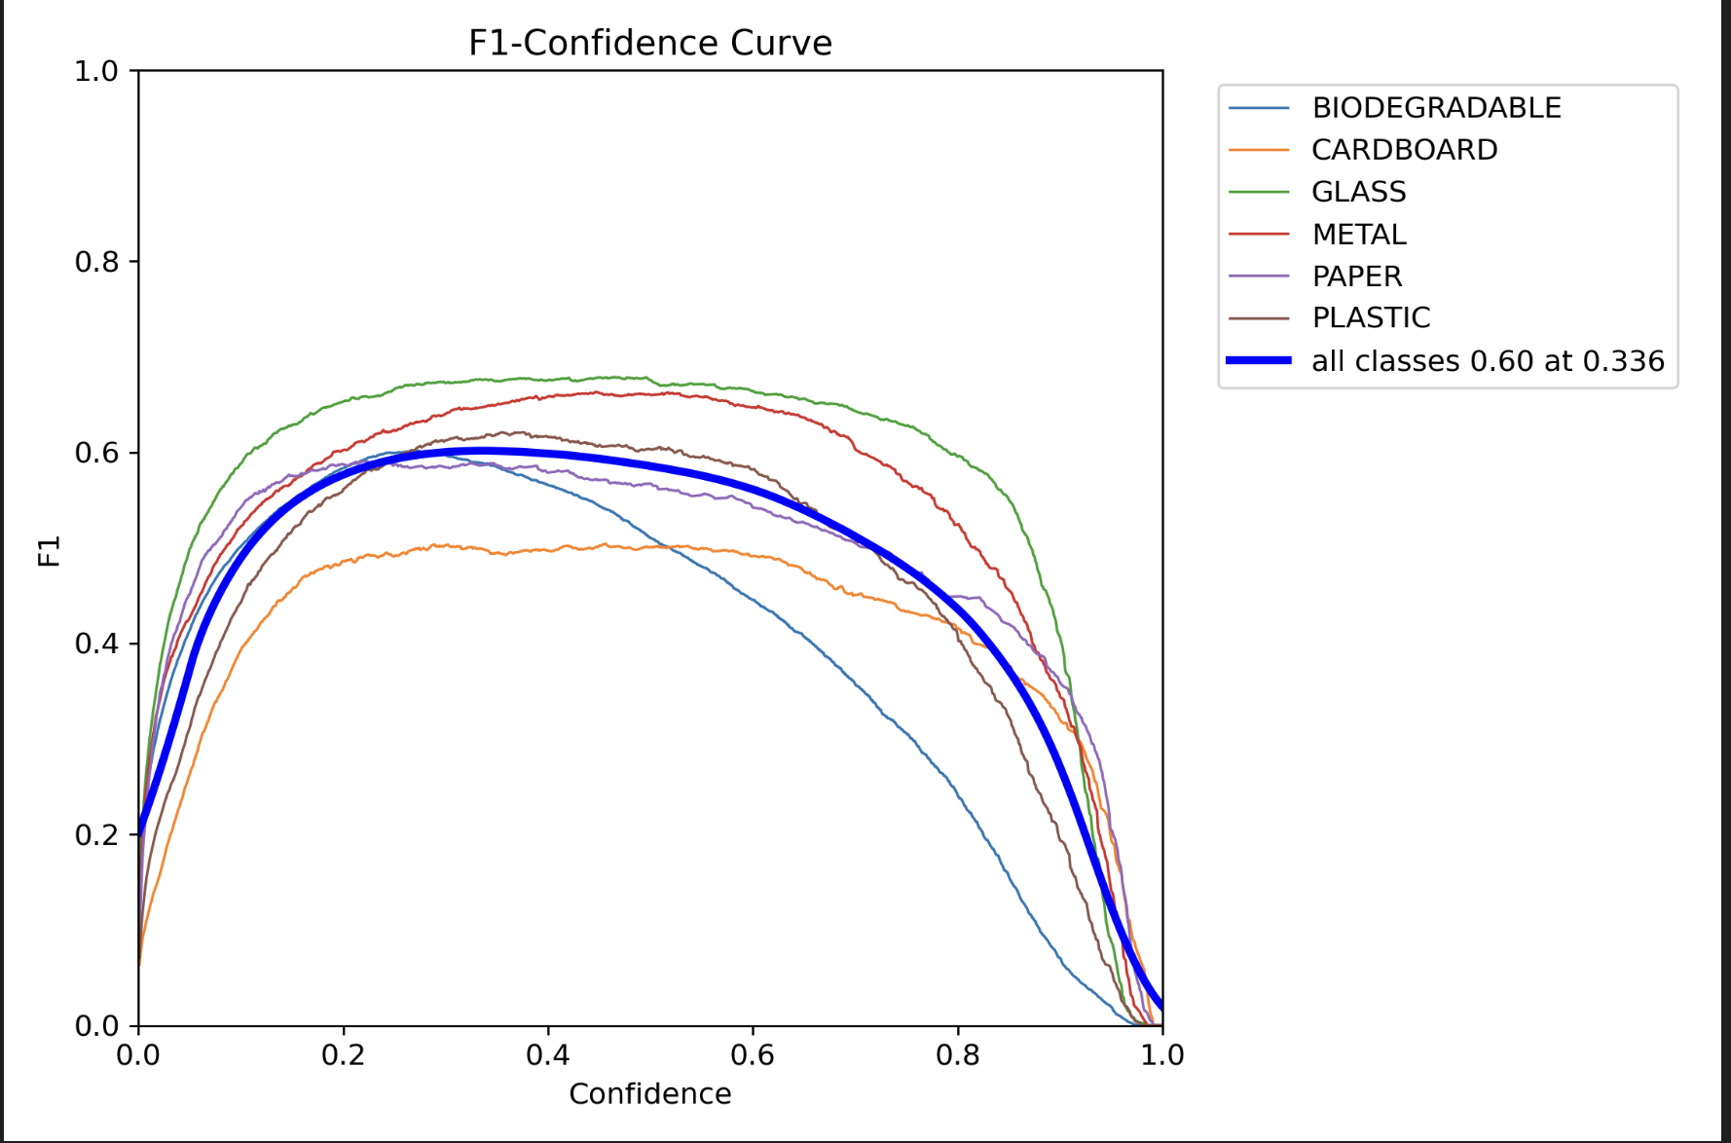
F1-Confidence Analysis

Slide 15
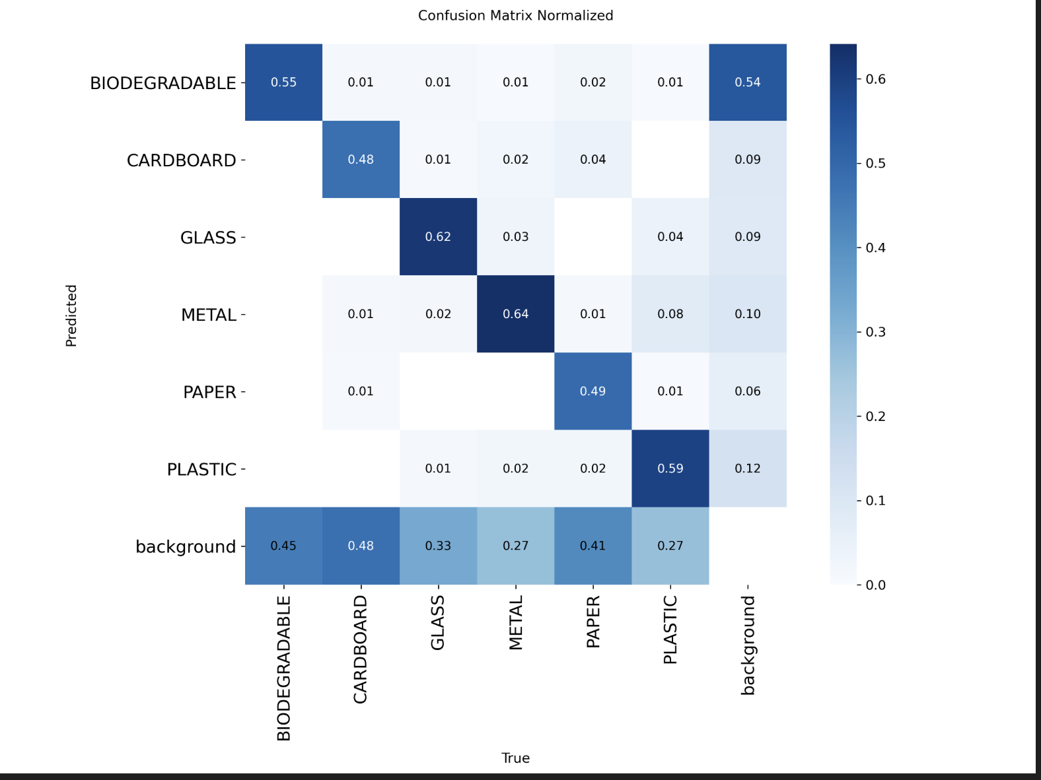
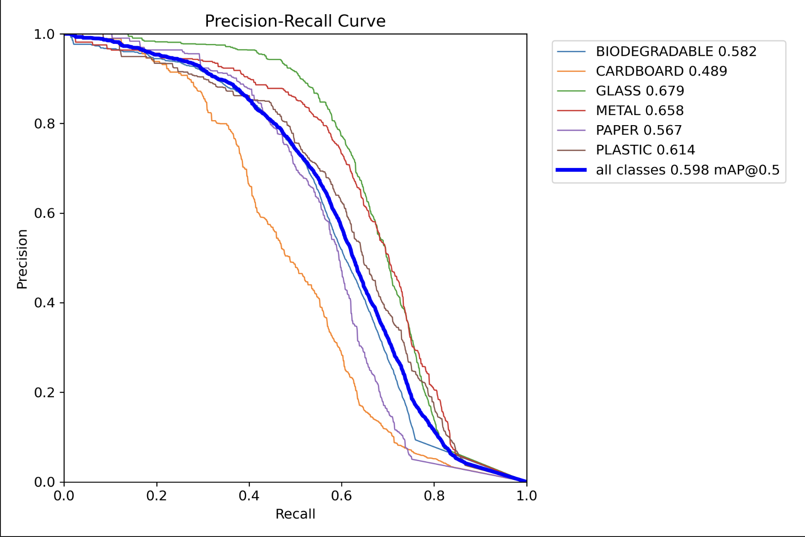
Precision-Recall Tradeoff & Confusion Trends

Slide 16
Final Inferences & Deployment Readiness
YOLOv8 shows strong real-world potential
Best confidence threshold: 0.33, yielding peak F1 = 0.60
Consistent convergence across all loss and metric curves
GLASS and METAL perform best; CARDBOARD needs further tuning
Misclassifications tied to visual similarity, especially PLASTIC and CARDBOARD
Overall mAP@50 = 0.598, Recall = 0.78, solid for production use

Slide 17
Discussion & Reflection
Key Learnings from Model Comparison
Baseline ViT showed high training accuracy but poor generalization
Augmented ViT improved macro recall: 0.90 → 0.93
PLASTIC recall improved: 0.73 → 0.84
YOLOv8 achieved mAP@50 = 0.598, recall = 0.78
YOLOv8 showed better generalization for deployment
Engineering Choices That Made a Difference
Switched to SoftTargetCrossEntropy for better class boundary handling
Applied dropout: drop_rate=0.2, attn_drop_rate=0.1
CosineAnnealingLR used for smoother convergence
Early stopping (patience=5) to avoid overfitting
Optuna optimized YOLOv8 hyperparameters
Dataset & Process Reflection
Original dataset was imbalanced
Applied stratified resplit (70/15/15) for fairness
Tasks divided: data prep, modeling, benchmarking, documentation
Tools: Google Colab Pro, PyTorch, timm, torchvision
Frequent checkpointing helped with session limitations
Future Plans
Smart bin integration
Explainability using Grad-CAm & ViT attention roolout
Data Expansion
Deployment Optimization - MobileviT, EfficientNet & quantized YOLO

Slide 18
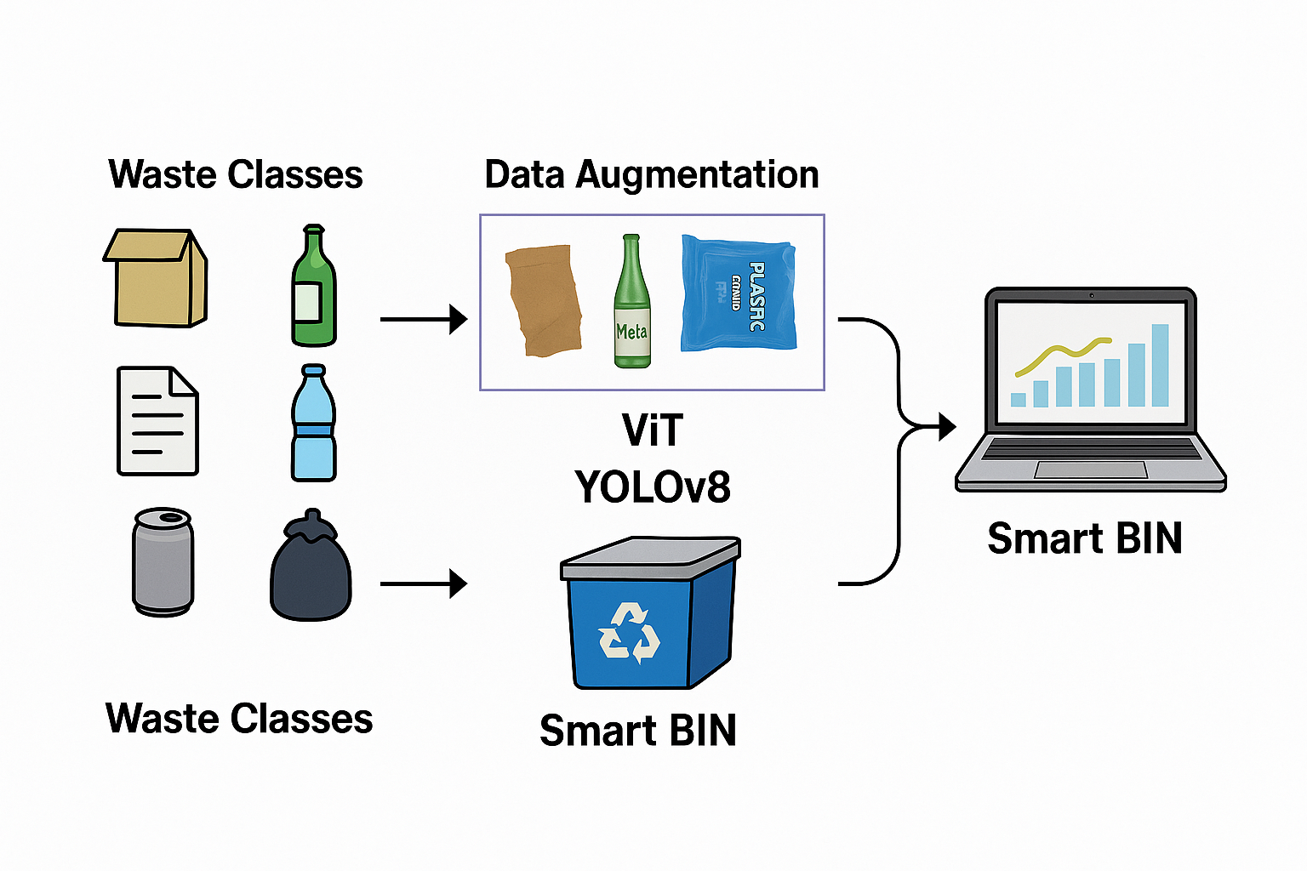
Conclusion
Built a waste classification system using ViT and YOLOv8 with transfer learning
Fixed dataset imbalance with a 70/15/15 split
Applied data augmentation and hyperparameter tuning
ViT achieved 93%+ accuracy, YOLOv8 reached mAP@50 = 0.598
Improved detection of challenging classes like Plastic and Glass
Ready for Smart BIN integration to support automated waste management

Slide 19
Thank you!

